Slide 1
Food World
Preety Mishra
Harshad Sathe
Vivekanand Shankar Acharya

Slide 2
Problem Statement
No time to wait outside a restaurant for your turn ?
Confused which restaurant to choose?
Want to see what your Friends or Family members are interested in?

Slide 3
Proposed Solution
Food World helps you search and book a restaurant at a button click
It also allows you to Follow your friends or family members
View their favorite restaurants, see their reviews
Add Restaurants to your Favorites List
Write Reviews for the restaurant

Slide 4
Architecture

Slide 5
Use cases
Login
User Login
Incorrect Login credentials
User Logout
Manage User
Register User
Edit/Update Profile
Delete User
Display User Profile
Connecting with other users
Find a User
Incorrect user search-Display error string
Display Searched User profile page
Follow a User
Unfollow a User
HOME>Find a user>Favorites>Click on a Restaurant for more Details

Slide 6
Use cases
Following:
Displays all users whom the logged-in user is following
Click on User>Following Users Profile page
Reviews:
Displays all the reviews of the logged in user
Click on Restaurant> Restaurant Detail Page
Click on Restaurant> Restaurant Detail Page>Add a Reviews
Favorites:
Displays all the favorite restaurants
Click on Restaurant > Restaurant Detail Page
Click on Restaurant > Restaurant Detail Page>Add to Favorites

Slide 7
Use cases
Reservation
Display all the reservation
Update reservation
Delete a Reservation
Search Restaurant
Search Restaurants by Name and Location
Search Restaurants by Name only
Search Restaurant by Location Name/Neighborhood only
Search Restaurant by Zip Code only
Display Search Results
Back to Search Page Button
Search Result Page> Click on Restaurant>Display Restaurant Details

Slide 8
Use cases
Restaurant Details
Click on Restaurant Website
Click on Restaurant Website>Press Browser Back Button
Make a Reservation
Enter Reservation Details and Reserve a Table.
TimeLine
View reviews of the users, the logged in user is following on Timeline.
Click on Restaurant Name>Restaurant Details Page

Slide 9
API
Google Places API’s
Place Searches
Place Details
Place Photos

Slide 10
Technology Stack
Frontend:
JSP + JavaScript + CSS
AJAX
JWS(WebServices)
Address
Restaurant
User
Backend:
JPA
MySQL
Server :
Apache Tomcat Server 7
Operating System:
Windows OS

Slide 11
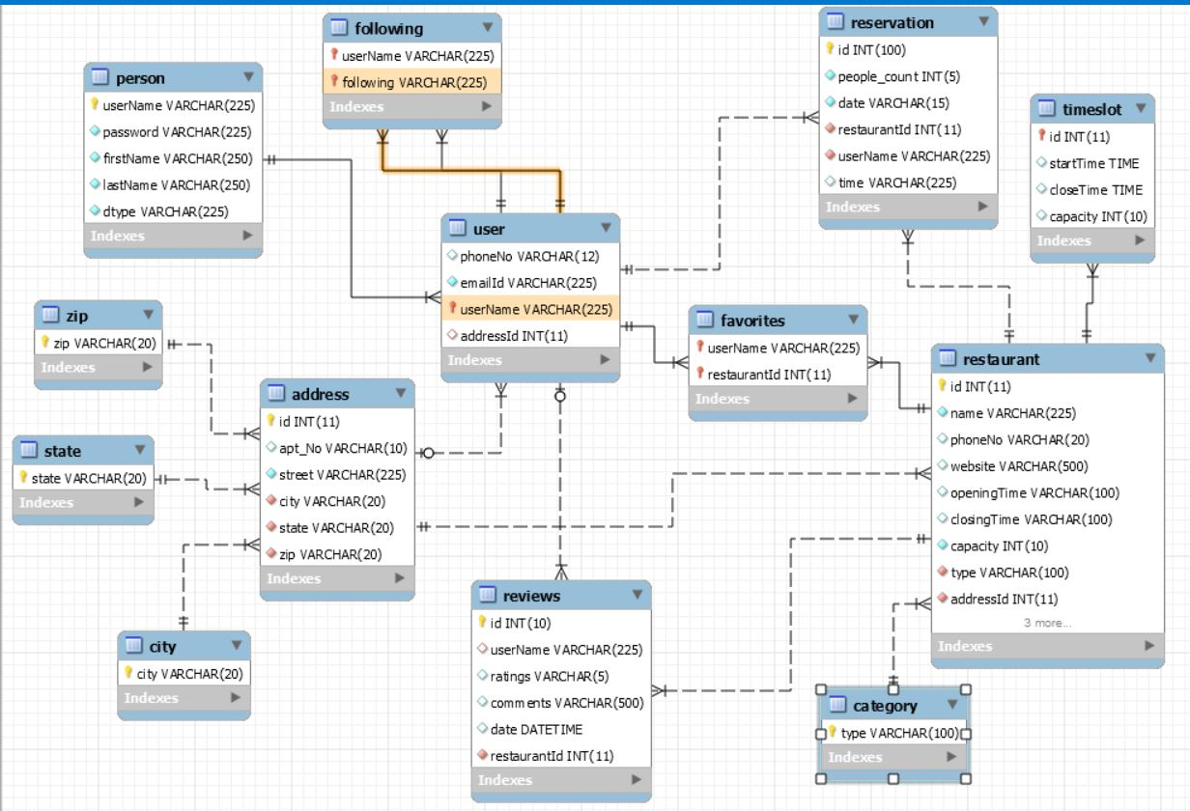
Data model(UML Class Diagram)

